Slide 1


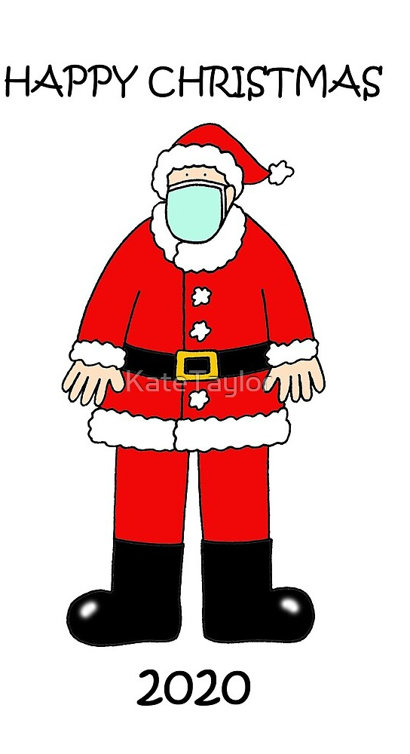
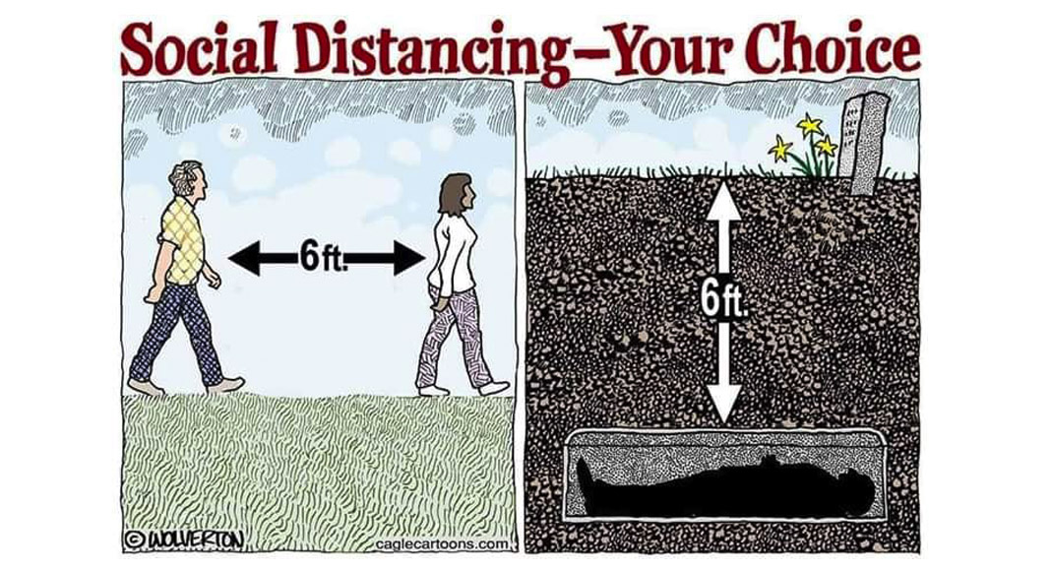
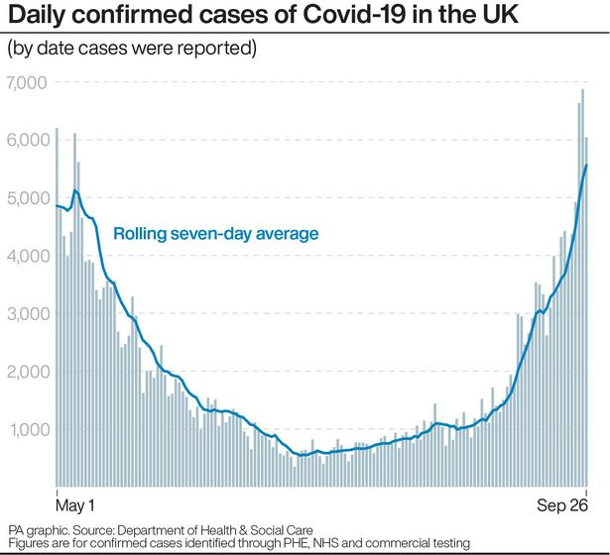
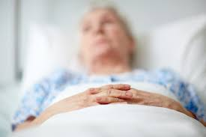
Shared Commitment - COVID-19 Rules F2F
We need to look out for each other I put my trust in you!
Remember whatever happens here you will bring it home to your households, my one surviving parent is 82! I have a frail auntie and uncle I would like to see all three of them for Xmas!
If you have any COVID symptoms do not come to class, follow the advice ring NHS and get a test
Do not come to class if you have recently travelled from abroad in the last two weeks from restricted area and should be in quarantine. There are heavy fines for breaches.

Slide 2
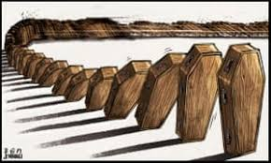

Shared Commitment – COVID-19 –F2F
Do not come to class if you have a cold or flue, you may be asymptomatic and infect everyone with COVID-19, you can catch both viruses together
Get to class a head of time, there is reduced capacity in the stairs and lift, if you are going to be late stay at home it is going to take more time to move around the building.
If I have to take a COVID-19 test or self isolate I will let you know. Could you agree to do the same and I will inform everyone in the class as quickly as I can. The track and trace may never find you!
Remember Its not imperative that you come in as all materials are online f2f is considered extra support
My mum wants you and me to be safe!

Slide 3


Before you log on!
Wash your hands, use hand gel.
Wipe down your keyboard and mouse.
Sign in to Track and Trace
Stay away from you colleagues at least 1 m
Cough/sneeze into your elbow
Do not touch your face
Avoid contact with anyone else
When you leave wipe down your keyboard and mouse

